Slide 1
Visual Analytics

Slide 2
Significance of visual analytics
Information Visualization
Data Representation
Data collection and binding
Structured Data
Unstructured data

Slide 3
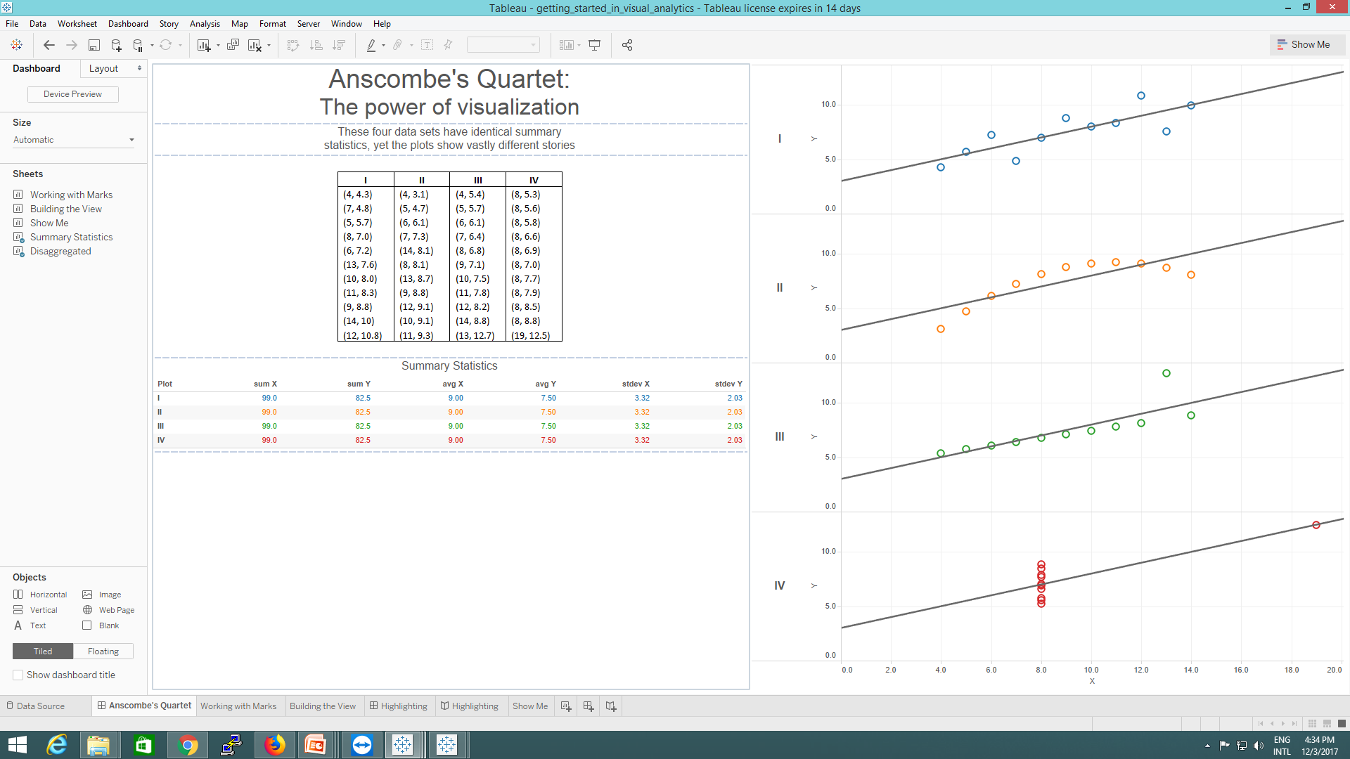

Slide 4



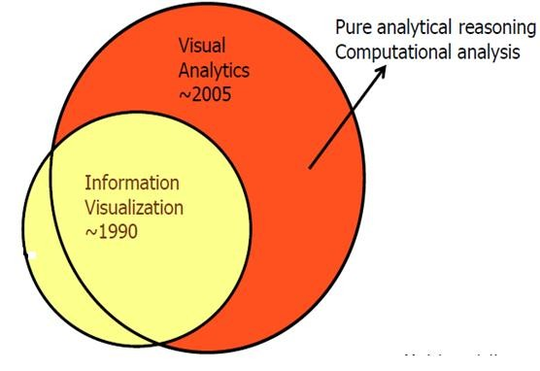
Definition: Visual Analytics
Is a scientific approach that extracts insight from large data sources via smart combination of ‘automatic’ algorithms as well as through interactive visualization interfaces.
VA purely adopts science of data analytical reasoning algorithms.
Science of analytical reasoning facilitated by interactive visual interfaces
Notes:
Benefits of Visual Analytics:
Improves the data exploration ,minizes the overall cost and improves the data analysis
VA makes easier the bulk of complex information for better decisions
VA enables enterprises to understand data much more quickly and to make faster ,better decisions
It offers the different trends of visualization ,so the understable data presentation models are generated

Slide 5
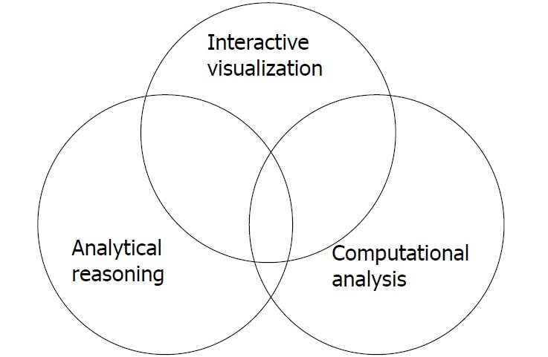
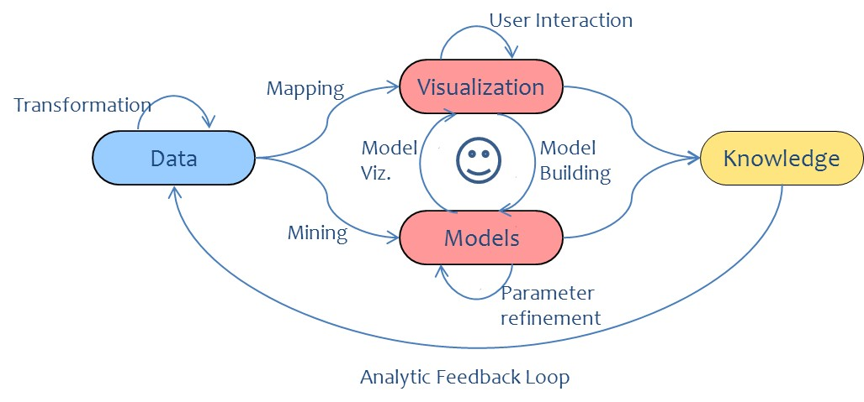
Basic Components of Visual Analytics Models
Smart combination of ‘automatic’ ML algorithms and Visual model building
A interactive discovery as well as effective interface to display the results (user interface)
Steering the computational side of the model (and graphics rendering)
Notes:
Visual Analytics is the Science of analytical reasoning facilitated by interactive visual interfaces
Combining approcaheds from different disciplines to enable the xploration of very large and heterogeneous datasets.
what is Visual analytics?
An integrated combination of data analytics and interactive visual exploration
Data analytics:Machine learning techniques,such as pattern,mining,classifiers,clustering,supervised learning techinques(neural n/w,) dimension reduction
Interactive visual exploration:Viusla filters ,multiple coordinated views ,brushing and linking ,paralled co-ordinates,scatter plots,glyph-based displays ,time-lines ,graphs and treemaps

Slide 6
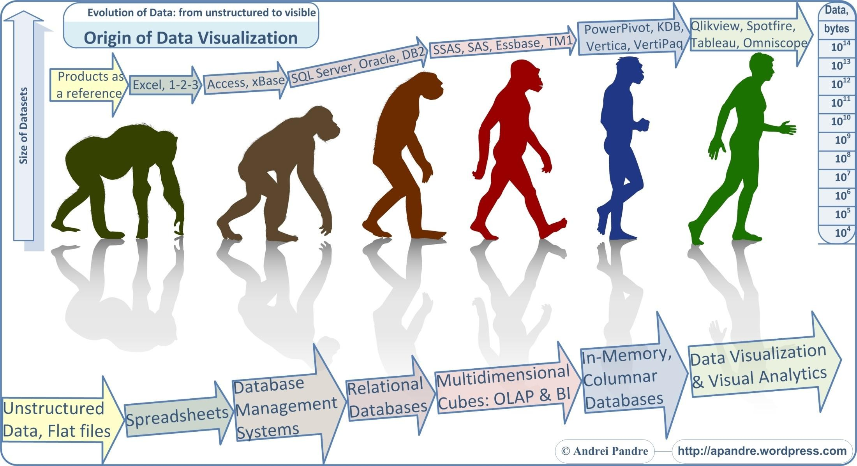

Slide 7

Visual Analytics
Vs
Information Visualization
Data that is overly summarized looses its ability to inform
When it’s too detailed, rapid interpretation of the data is compromised.
Visual Analytics bridges this gap by providing the right style of Data Visualization.

Slide 8
Information Visualization | Visual analytics
Mere visualization interface does not necessarily deal with an analysis tasks nor use advanced data analysis algorithms eg. Visualizing the election results on due date. | Visual analytics interface reflects the outcome of statistical based data analysis techniques and its impact in decision-making. eg. Forecasting the election results.
Not much challenge (mere visualizing of results) | The challenge is to identify the best automated algorithm for the analysis task at hand, identify its limits which can not be further automated and then develop a tightly integrated visualization solution with adequately integrates the best automated analysis algorithms with appropriate interaction techniques.
Impression | Creativity is needed to understand how perception issues can help bring more intelligence into the analytical process by “learning” from users’ behavior and effective use of the visualization – That is the reason you are here
Fixed and can not vary | Vary from person and person eg. Your lab results
 |  | Both has overlap…

Slide 9






Data Representation
W.R.T Information Storage
W.R.T Encoding
W.R.T Graphics

Slide 10



Information Storage
Bytes(8 bits)
Kilobyte (1000 bytes)
Megabyte (1 000 000 bytes)
Gigabyte (1 000 000 000 bytes)
4. Terabyte (1 000 000 000 000 bytes)
5. Petabyte (1 000 000 000 000 000 bytes)
6. Exabyte (1 000 000 000 000 000 000 bytes)
7. Zettabyte (1 000 000 000 000 000 000 000 bytes)
8. Yottabyte (1 000 000 000 000 000 000 000 000 bytes)
9. Xenottabyte (1 000 000 000 000 000 000 000 000 000 bytes)
10. Shilentnobyte (1 000 000 000 000 000 000 000 000 000 000 bytes)
11. Domegemegrottebyte (1 000 000 000 000 000 000 000 000 000 000 0

Slide 11
Data Representation w.r.t Memory/Storage
Bit <- smallest
Byte
Kilobyte
Megabyte
Gigabyte
Terabyte
• ..............< biggest
A bit is the smallest unit of memory
There are 8 bits in a byte
There are 1024 bytes in a kilobyte
There are 1024 Kb in a Megabyte
There are 1024 Mb in a Gigabyte
There are 1024 Gb in a Terabyte

Slide 12


Data Representation: w.r.t Character/Text/DB/Table encoding
ASCII
UNICODE
oUTF-8

Slide 13
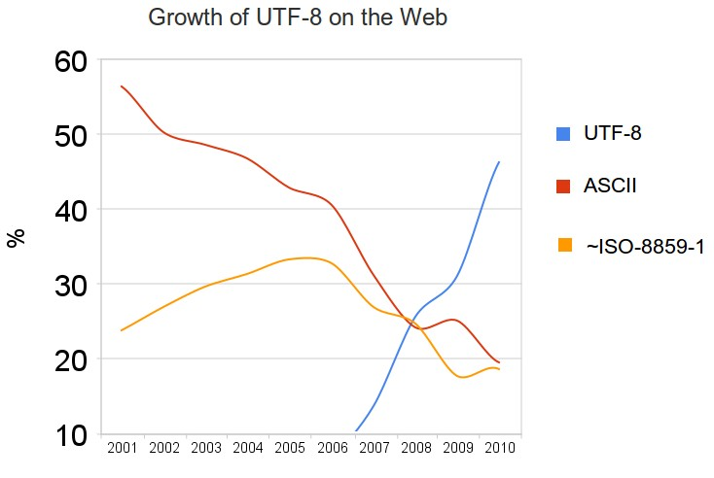

UNICODE is current computing standard for the consistent encoding, representation and handling of text expressed in most of the world’s writing systems. It is generally 16 bit code which is used to represent a lot more characters, obviously takes more memory than ASCII

Slide 14



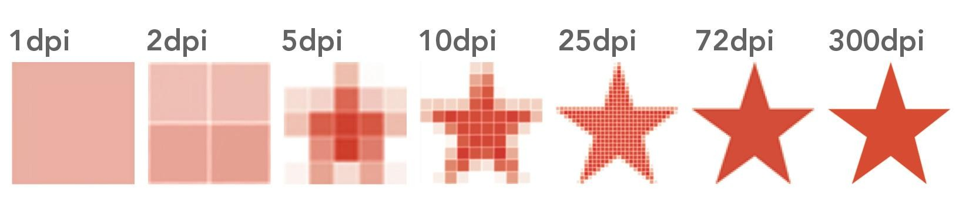

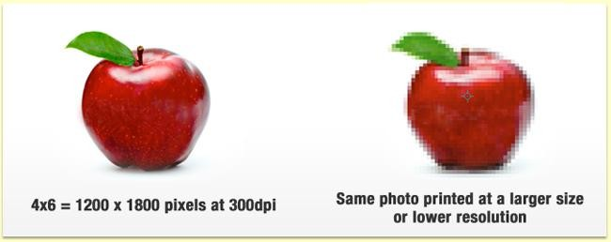
About image representation - Resolution
(Suitable for Raster based models and its representation)
A screen display of 800 x 600 lower resolution
A screen display of 1024 x 768 is of higher resolution

Slide 15
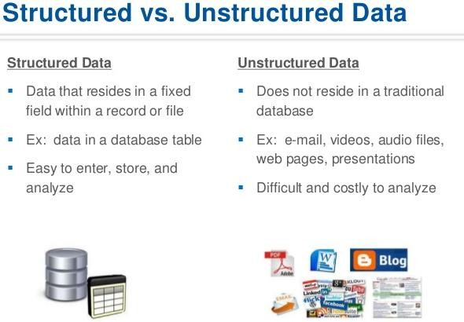

Slide 16
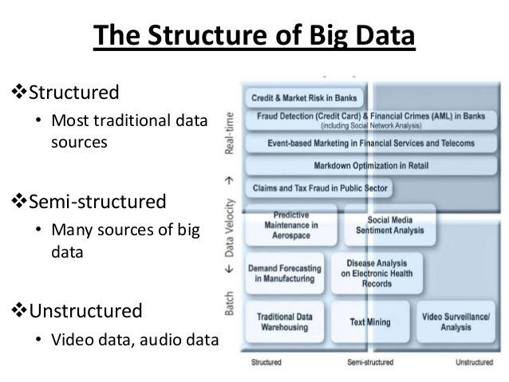

Slide 17
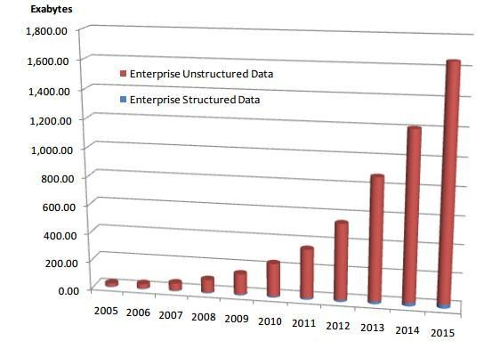
Why Unstructured Data (w.r.t Big Data context)
Data science and business analytics works with both structured and unstructured data. Yet the future belongs to unstructured or semi- structured data

Slide 18



Features of unstructured data
Does not reside in traditional databases and data warehouses
May have an internal structure, but does not fit
a relational data model
Generated by both humans and machines : Textual and multimedia content Machine-to-machine communication
Examples
Personal messaging – email, instant messages, tweets, chat Business documents – business reports, presentations, survey responses
Web content – web pages, blogs, wikis, audio files, photos, videos Sensor output – satellite imagery, geolocation data, scanner transactions

Slide 19

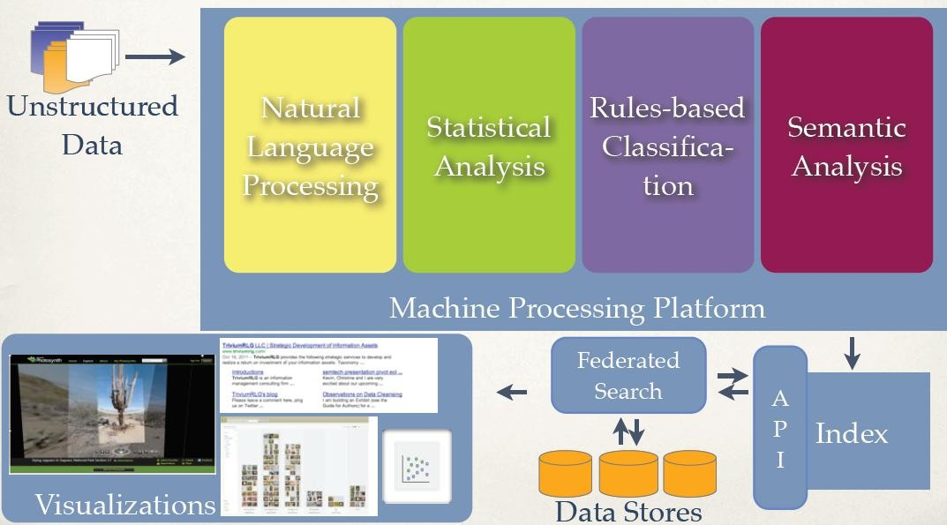
Visualizing the Unstructured Data
•…….unstructured data is the undeniable truth of the times, with all kinds of data captured in all walks of life including emails, texts, video surveillance cameras, phone calls, point of sale transactions, medical records or, in other words, anything and everything that captures information via various mechanisms.
Does not assist in other visualizations or transformations without machine processing

Slide 20
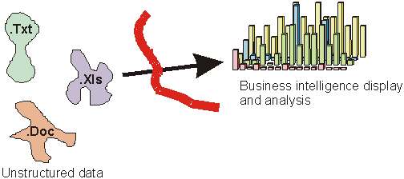
Big Data: Steps in Visualizing the Unstructured Data
Mining the value from unstructured data is not as easy as structured data as it can't be
sorted, searched, analyzed, visualized as in the same way as structured data.
It requires new approach/processes to extract intelligence/analytic model, in sharing the information and deriving the values.
Organizations need a better way to mine for this gold.
To get to that value, you will need to consider these steps.
1. Draw a map to the gold – Identify/trace out the input sources 2.
3.
4.
5.
6.
7.
8.
Create a legend Automate Visualize
i.e add context
Using your mining/analytic techniques
with appropriate plotting techniques
Enable interactive components of visualization
Extract/derive profit intelligence Possible acts on the intelligence Face the consequences
In the context of Business Intelligence Drill down, Drill across

Slide 21

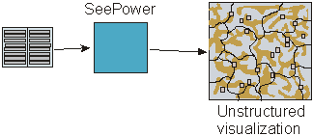
Interactive Visualization functions - The most important component of Visualization.
Once the mapping is created with the help of ML, the same can be queried/searched and visualized in multiple ways/plots .
W.r.t evolving needs, the data may be re-organized according to its contents inside.
The individual occurrences of words can be examined and its pattern needs to be visualized/brought out (the words can be searched in a drill down manner).
Many related documents/source can be handled and the relationship between many documents/source can be evolved with the support of additional MLA
But all needs to be visualized through interactive visualization functions.

Slide 22

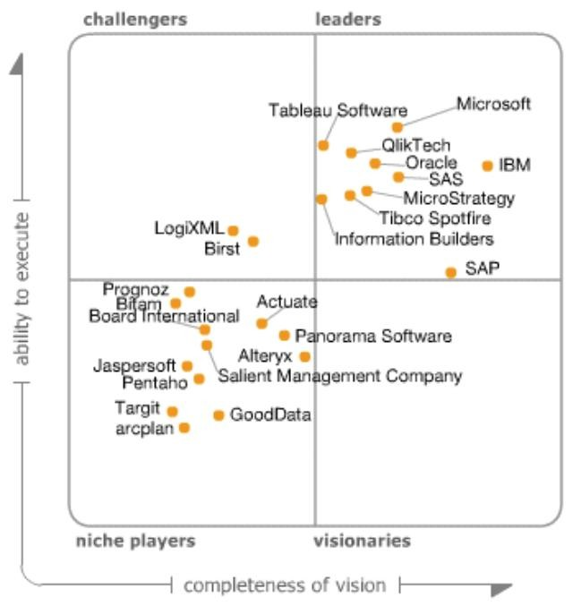
Leading Tools for Visual Analytics

Slide 23
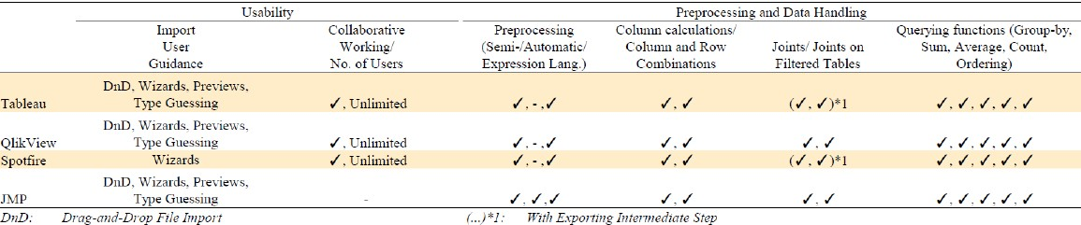
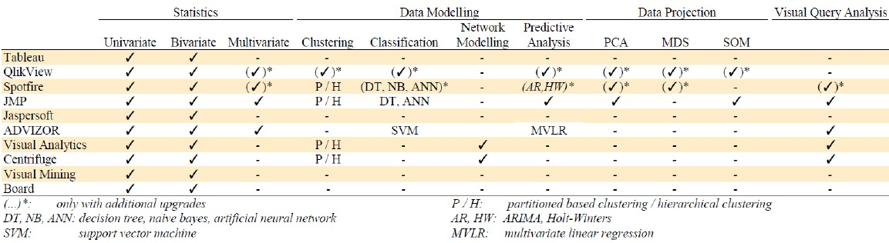
Comparison of Commercial Visual Analytical Tools
w.r.t Data Management
w.r.t Data Modelling

Slide 24
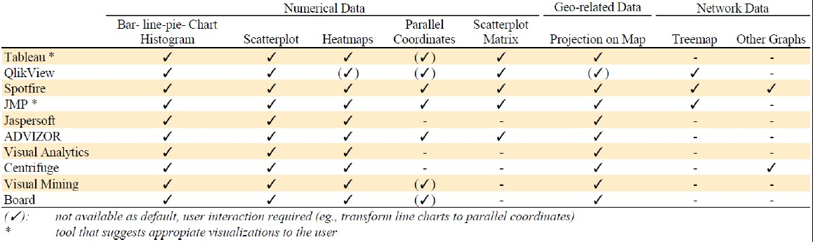
w.r.t Visualization/Plots
Comparison of Commercial Visual Analytical Tools

Slide 25
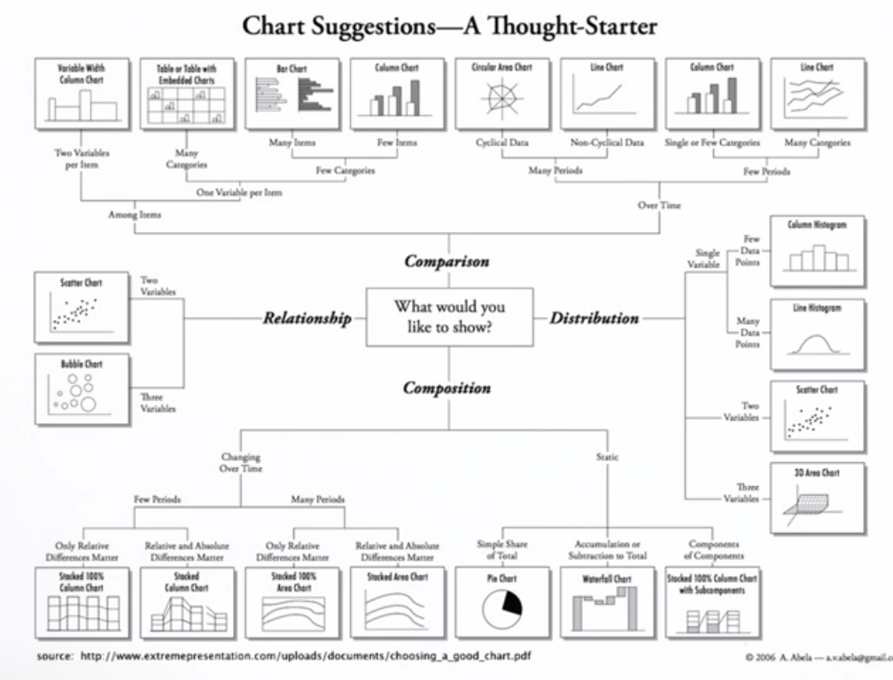

Slide 26
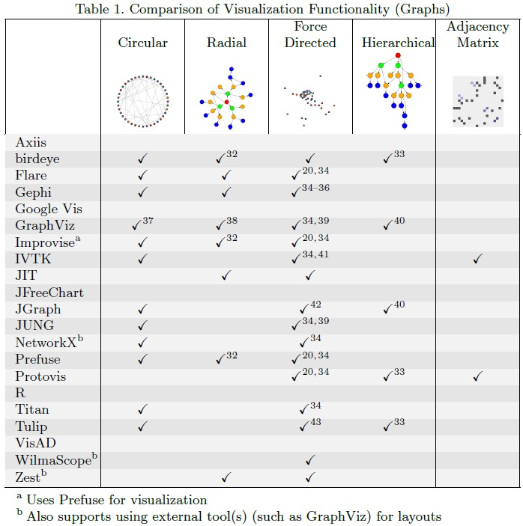
Comparison of Open Source Visual Analytical Tools

Slide 27
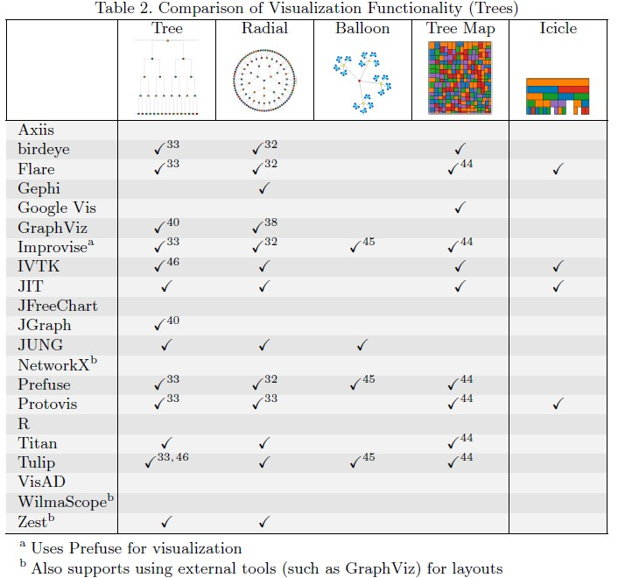
Comparison of Open Source Visual Analytical Tools

Slide 28
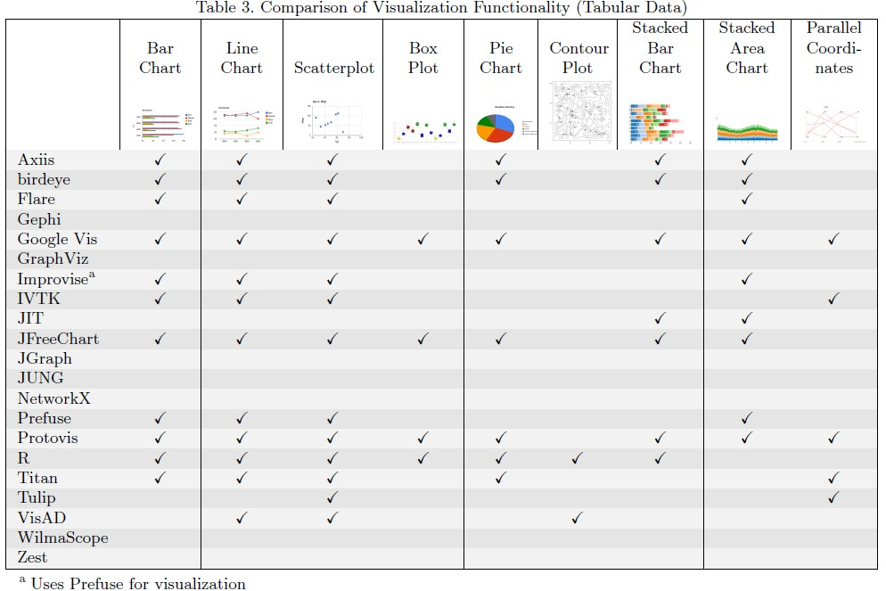
Comparison of Open Source Visual Analytical Tools

Slide 29
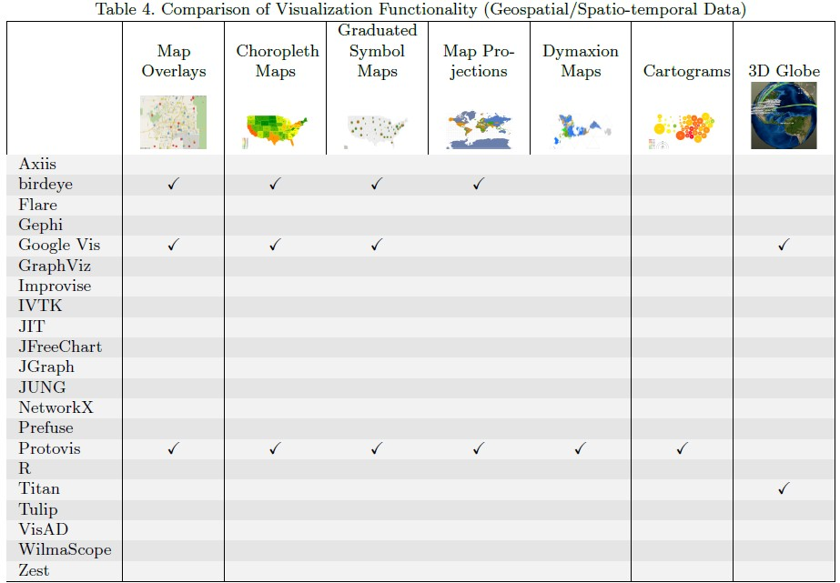
Comparison of Open Source Visual Analytical Tools

Slide 30
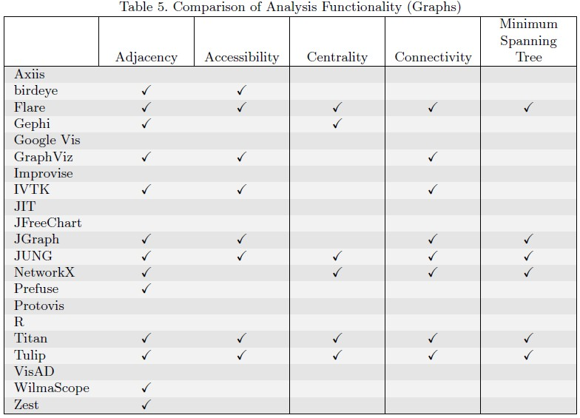
Comparison of Open Source Visual Analytical Tools

Slide 31
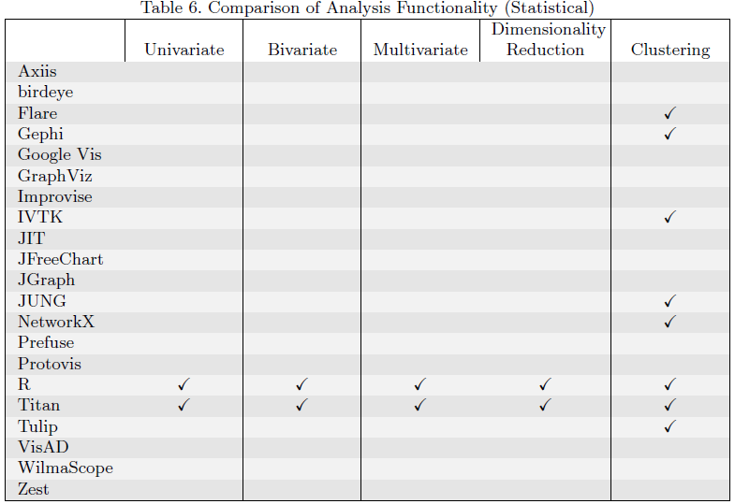
Comparison of Open Source Visual Analytical Tools

Slide 32
